Slide 1
  Biometric Performance
Date: March 2022
Location
@qualcomm
Speaker name : Reza Barazideh

Slide 2
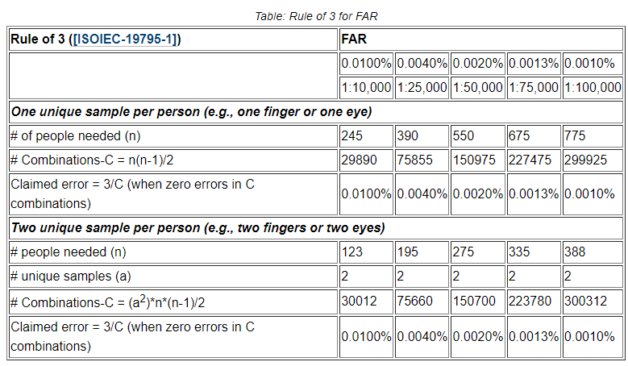
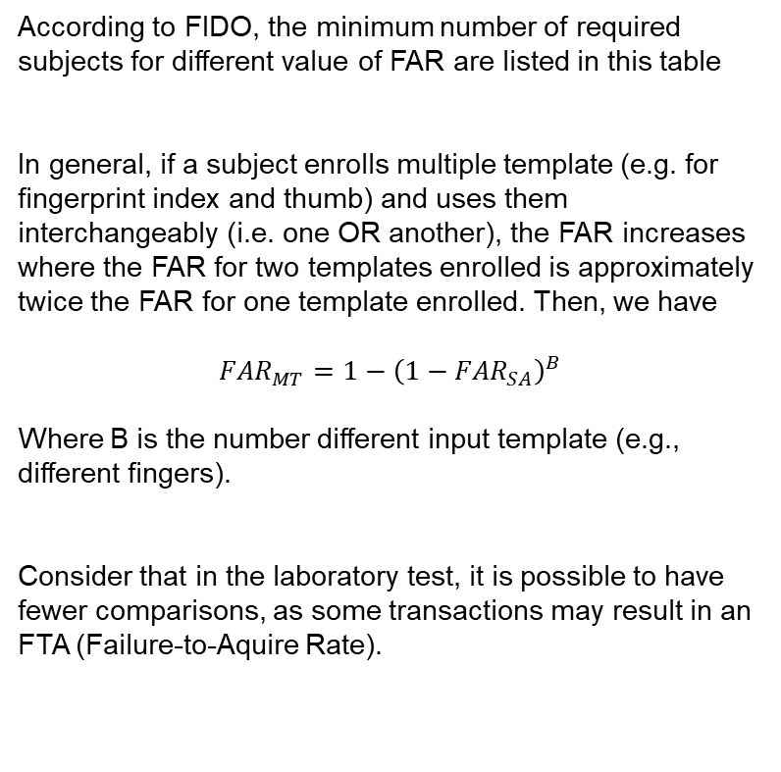
FIDO Requirements for Biometric Performance
Fingerprint
2D Facial
According to FIDO, the minimum number of required subjects for different value of FAR are listed in this table
In general, if a subject enrolls multiple template (e.g. for fingerprint index and thumb) and uses them interchangeably (i.e. one OR another), the FAR increases where the FAR for two templates enrolled is approximately twice the FAR for one template enrolled. Then, we have
$${FAR}_{MT}=1−{\left(1−{FAR}_{SA}\right)}^{B}$$
Where B is the number different input template (e.g., different fingers).
Consider that in the laboratory test, it is possible to have fewer comparisons, as some transactions may result in an FTA (Failure-to-Aquire Rate).
3D Facial

Slide 3
Difficulty of fulfilling the Biometric Performance requirements
According to the requirements in the current draft of TS.53 and the requirements in FIDO, performing the test by real person has some difficulties such as:
1- FIDO is the only organization that can do the test right now
2- Thera are many barriers for vendor to do the test by itself such as:
The population is not representative of the target market in relationship to age, gender, and race
Ignoring the population problem, it takes a lot of time and resources to perform the test as required by FIDO
For example, if we want to test 3D facial performance, for testing each device we need:
Number of required subject: 775
Time for each 3D scanning : 60s
Total time = 775*60s (13 Hours)

